Slide 1
Digital Portfolio
STUDENT NAME: CHAITANYA KISHORE
REGISTER NO AND NMID: 222404552
DEPARTMENT: BSC SOFTWARE APPLICATIONS
COLLEGE: AGURCHAND MANMULL JAIN COLLEGE

Slide 2
PROJECT TITLE
DIGITAL
PORTFOLIO

Slide 3


AGENDA
Problem Statement
Project Overview
End Users
Tools and Technologies
Portfolio design and Layout
Features and Functionality
Results and Screenshots
Conclusion
Github Link
3/21/2024 Annual Review

Slide 4

PROBLEM STATEMENT 1)Building The Structure 2)Giving Perfect Colors 3)Inserting pictures 4)Making Scrolling smooth 5) Making it Responsive

Slide 5

PROJECT OVERVIEW A Digital Portfolio fully attached about my skills in the software world and it holds my project I have linked my github,linkedin,Twitter profile

Slide 6

WHO ARE THE END USERS? The End Users are The Companies I go for Interview My Online Clients

Slide 7

TOOLS AND TECHNIQUES HTML CSS JAVASCRIPT

Slide 8
POTFOLIO DESIGN AND LAYOUT
It has a maginificent Purple blended violet colors and it has my profile photo , My name in the Starting
after scrolling down you can find my projects , and what Skills do i have and lastly you got a information box
to fill up your details and get in touch with me...
- Thank you!!
8

Slide 9
FEATURES AND FUNCTIONALITY Displays My Essential Details Scrolls Smootly it has a Arrow button in the left to scroll up from down

Slide 10
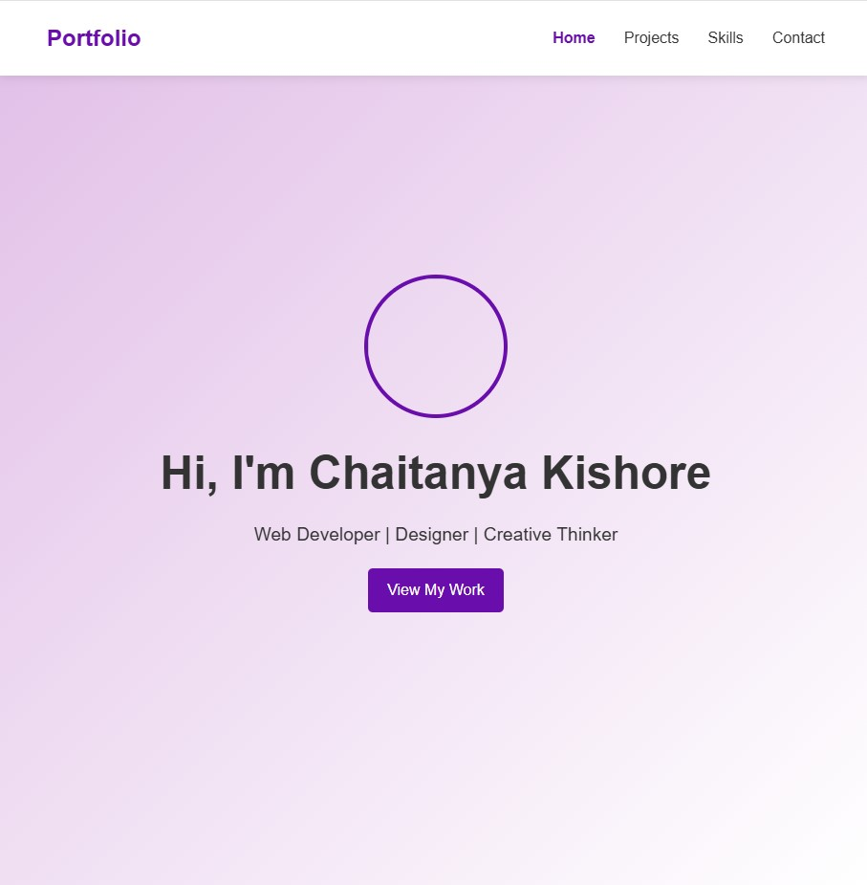
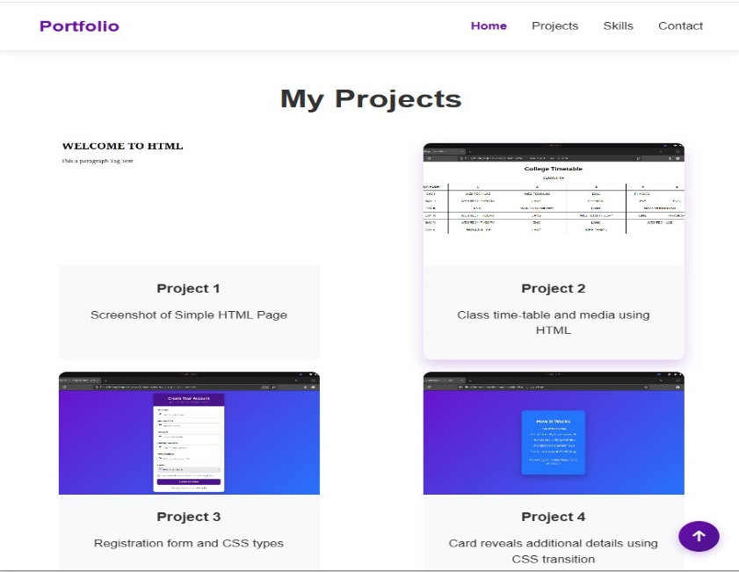

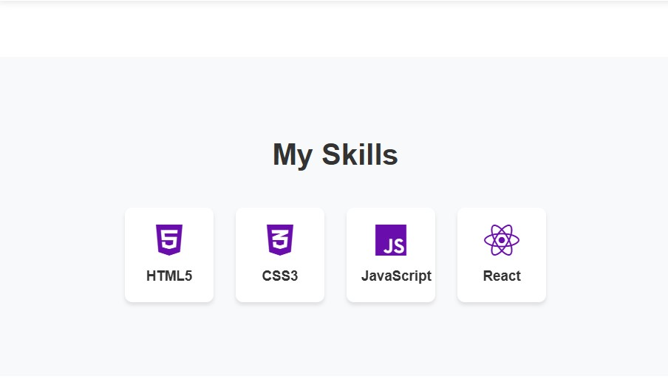
RESULTS AND SCREENSHOTS
3/21/2024 Annual Review
10

Slide 11
CONCLUSION I have created this Portfolio with my Hardwork and consistency
Server link: https://github.com/Chaitanyakishore2/portfolio.git
Deployment link: https://chaitanyakishore2.github.io/portfolio/
11

